Slide 1
Learning to Program in Python
Concept 4
More Conditionals
(if else elif statements)
Notes:
This lesson will focus on if..elif..else statements. It is assumed the previous lesson on if statements has been covered.
It is assumed that variables, data types, casting and basic input-output have been covered before this lesson.
Conditionals are considered by many to be the first key Threshold Concept in learning how to Program.
The tasks and ideas would require several classes to ensure students have time to engage with the concept.

Slide 2
Learning Intentions
From this lesson the students will:
Understand the concept of conditional if, else and elif statements.
Read and Write code to improve on previous programs.
Design programs with a better User Interface (UI)
Notes:
The main Learning Outcomes (LO) achieved are highlighted throughout the lesson and tasks.
The list is not exhaustive, and consultation with the LCCS spec is encouraged at all times throughout the implementation of the course.

Slide 3
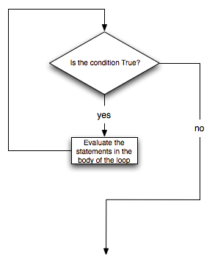
RECAP on the if flowchart
Flow Chart starts here
Execute these lines
Execute your code
Continue
Notes:
A FLOW chart representation ….

Slide 4

if Statement
if statement: executes a set of commands only if a certain condition is True.
Otherwise, the commands are skipped.
  Syntax:
indentation
Notes:
The If statement is read as “If the temperature is greater than zero is True then execute the following commands”
Note the indentation.

Slide 5
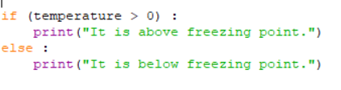
if .. else Statement
If the condition is True execute the statements Otherwise execute another set of statements
  Syntax:
LO 1.1 students should be able to describe a systematic process for solving problems and making decisions
Notes:
If ..else is useful for a test that is either True or False, greater or less than, on or off, or any binary test on a condition.

Slide 6
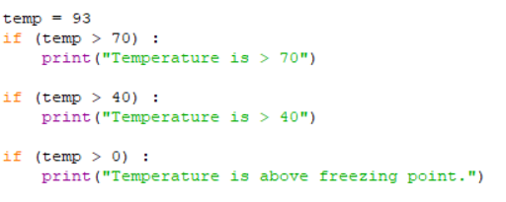
Multiple if statements
Remember all of these if statements were executed
What if we wanted to :
check if temp > 70 or
else check if temp > 40 or
else if check temp > 0
but not all 3 of them?
Notes:
Introduce the concept of if … else statements

Slide 7
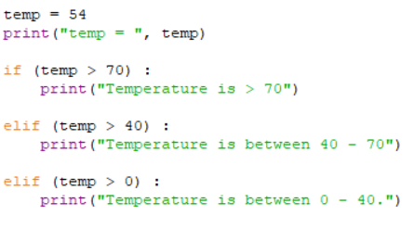
if and elif statements
What do you think this code will output?
Notes:
Introduce the concept of if … else statements.
elif stands for “else if”
The PRIMM method will encourage engagement. (Predict Run Investigate Modify Make)

Slide 8

elif (else if) output
Only 1 of the statements is printed since it can only be 1 or the other or the other etc……
LO 1.4 students should be able to solve problems using skills of logic
Notes:
Now the output only shows one statement, and not the other 2 statements.

Slide 9
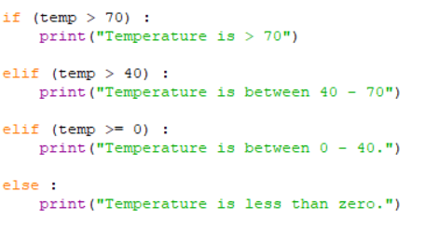
if..elif..else statements
Predict the output for temperatures of 70? 40? 0? -5?
Notes:
elif stands for “else if”
Note that the else statement sweeps up any condition that wasn’t True in the preceding if..elif statements.
temp = 70 will output : Temperature is between 40 – 70
temp = 40 will output : Temperature is between 0 – 40.
temp = 0 will output : Temperature is between 0 – 40.
temp = -5 will output : Temperature is less than zero.

Slide 10
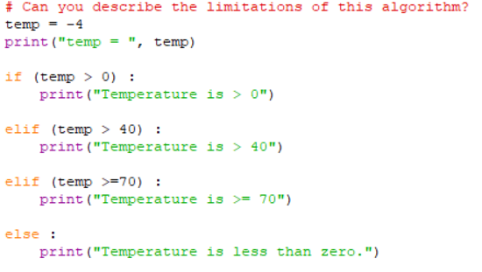
if..elif..else statements
LO 2.21 students should be able to critically reflect on and identify limitations in completed code and suggest possible improvements (HL)
Notes:
elif stands for “else if”
Note that the else statement sweeps up any condition that wasn’t True in the preceding if..elif statements.
The elif statements are REDUNDANT. The only outputs possible are Temperature is > 0 OR Temperature is less than zero.
Also, another limitation is what the algorithm will do for temp = 0. Its value is not captured accurately by the output to the user.

Slide 11
Use if..elif..else to improve if programs
REVISIT
We are going to look again at programs written during the lesson on if statements.
REVIEW
Discuss how to use if..elif..else statements to improve the efficiency of the programs.
RE-DESIGN
Modify your programs and ensure they execute correctly.
LO 1.23 students should be able reflect and communicate on the design and development process
Notes:
This set of exercises is aimed at the design process to encourage students to reflect upon how to create better, more efficient artefacts.

Slide 12
REMINDER of Relational Operators for making comparisons
Relational Operator | True / False | Operation | Answer
== | 1 + 1 == 2 | equals | True
!= | 3.2 != 2.5 | does not equal | True
< | 10 < 5 | less than | False
> | 10 > 5 | greater than | True
<= | 24 <= 13 | less than or equal to | False
>= | 5.0 >= 5.0 | greater than or equal to | True
Notes:
REMINDER of the full table of relational operators that allow us to make comparisons of equality and inequality.
Draw attention to the “equals” relational operator. Ask why there are two equals. (One equal sign is an assignment!!)
The PRIMM method will encourage engagement. (Predict Run Investigate Modify Make)

Slide 13
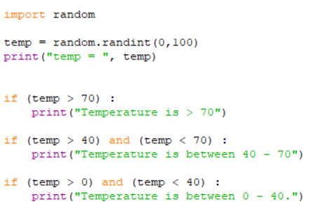
1st Program to RE-DESIGN to ensure temperatures 0, 40, and 70 are included.
Notes:
The flow of the improved program should be if…elif…else. (Although not strictly necessary in this case)
In order to catch the temperatures of 0 and 40 for example, the last conditional should read (temp >= 0) and (temp <= 40).
The students must decide in advance if the range of temperatures are inclusive or exclusive.
So their program should tell the user this is what is happening.

Slide 14
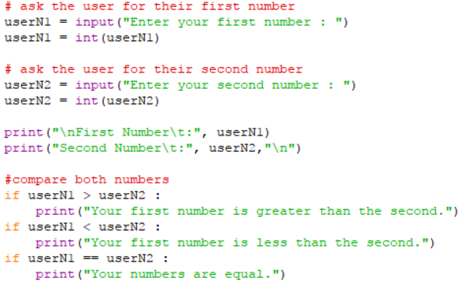
2nd Program to RE-DESIGN using
if ..elif ..else statements
Notes:
The flow of the improved program should include if…elif…else.
The benefit of the improved program is that less lines of code are executed, to perform the same function.

Slide 15

A 3rd Program to RE-DESIGN
Create Your Own … Guessing Game
Your task is to write a program that asks the user to guess a number between 1 and 5 (inclusive) that your program randomly generates.
You must write the algorithm first and then code it in Python, using if ..elif..else statements for more efficient code.
User Interface
You must tell the user if they guessed correctly and congratulate them.
If they guessed incorrectly, you must tell them if their guess was too high or too low. And let them have 1 more go. If they are wrong, then say Hard Luck!!!!
Notes:
This is the bones of the guessing game. At this point, students can control the flow of their programs using if..elif..else statements.
Students must write the algorithm first. The next slide shows a possible algorithm in pseudo-code, to aid students who may have difficulties.
When students study LOOPS they will be able to offer the user unlimited amount of turns, the option to exit the program, and greater efficiency in the code.
The Scratch symbol indicates that this task should also be done in Scratch (or similar block-based language). The html resource, containing the Scratch program and guiding the students, is part of the same folder as this Python resource.

Slide 16
pseudocode .. for guessing game
gameNumber = a random number between 1 and 5;
userNumber = user’s first guess;
if userNumber == gameNumber { print congratulations; }
elif userNumber > gameNumber { print your guess is too high; }
else { print your guess is too low; }
if userNumber != gameNumber {
userNumber = user’s second guess;
if userNumber == gameNumber {
print congratulations; }
else { print Hard Luck; }
}
Notes:
Students finding it hard to write the algorithm/program unaided could use this pseudo code as a scaffold for writing their own code.
The NESTED if..else statements are further reinforced in the additional resources related to LOs.
On ncca.ie, use the html resource to write the guessing game in Scratch and analyse its CT level. Compare the 2 programs and the 2 User Interfaces.

Slide 17

CT Challenge… Basic Caesar Shift
An anonymous client wants a program which will create a custom Caesar Shift Code.
But firstly, you must ask the user for a letter of the alphabet and encode that letter.
The program should ask the user for the key (the number of letter shifts).
Then output the coded letter.
LO 2.17 students should be able to use ASCII and Unicode character sets to encode/decode a message and consider the importance of having such standards
Notes:
There are if..elif..else tests and conditions in this task.
It is a CT challenge on the ncca website, aligned to the concepts and tasks in this section (and on a html platform)
Students should be encouraged to decompose the program and build up the functionality from working code.
Students must write the algorithm first. The CT Challenge will guide the students through the process.
A later CT challenge requires the student to develop a program to encode entire strings using a Caesar Shift.

Slide 18
CT Challenge… Grade Converter
Your task is to write a program that asks the user for a mark between 0 and 100.
The mark will be converted to a grade such as H1, H2, H3 etc. for Higher Level or O1, O2, O3, etc. for Ordinary Level.
User Interface
Your program will prompt the user for the level first and then the mark.
The output will display the mark entered and the corresponding grade.
When completed, test your program and marks between 0 and 100 and also with marks outside 0 – 100.
LO 2.20 students should be able to identify and fix/debug warnings and errors in computer code and modify as required
Notes:
There are a lot of tests and conditions in this task.
It is a CT challenge on the ncca website, aligned to the concepts and tasks in this section (and on a html platform)
Students should be encouraged to decompose the program and build up the functionality from working code.
Students must write the algorithm first. The CT Challenge will guide the students through the process.
The next slide shows some suggestions on how to code this problem.
When students study LOOPS they will be able to offer the user unlimited amount of turns and the option to exit the program.

Slide 19
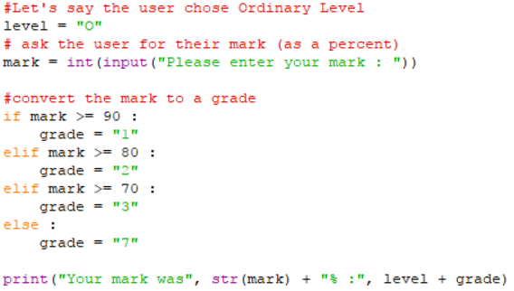
Some Suggestions for the program
# HINT
level = “H”
grade = “2”
level + grade will give “H2”
Notes:
The partially written solution above is to suggest a way of coding the program to convert marks to grades.
The student will need to add a lot more code to this to solve the entire problem.
When complete and working, the students could try to enhance their code to check for marks entered that are not between 0 and 100%.

Slide 20
Lesson Review
As a result of this lesson I am able to:
Understand the concept of conditional if, else and elif statements.
Read and Write code to improve on previous programs.
Design programs with a better User Interface (UI)
Notes:
Review the extent to which the L)s have been achieved in these tasks, and also in the CT challenge, the eTasks, the equivalent program written in Scratch, and the microbit and conditionals in Python videos. The main LOs addressed are Students should be able to :
1.1 describe a systematic process for solving problems and making decisions
1.2 explain how the power of computing enables different solutions to difficult problems
1.4 solve problems using skills of logic
1.22 read, write, test, and modify computer programs
1.23 reflect and communicate on the design and development process
2.20 identify and fix/debug warnings and errors in computer code and modify as required
1.15 consider the quality of the user experience when interacting with computers (further elements of this LO developed at a later stage)

